Slide 1
DH 110: Final Presentation Slide Deck
Claudia Alvarez, Emma Chang, Stella Kang, Isha Rajput, Miranda Solorio

Slide 2
Ethnographic Observations
Construction: "Accessibility Routes on campus have been reoriented to allow for seismic upgrades of Powell Library. The ongoing reconstruction of this area and the removal of key accessibility routes have prolonged the amount of time it would usually take to navigate toward central campus"
Accessible facilities: "In the building with the CAE office, we noticed that the water fountain was lower which allows easier access to individuals with disabilities. However, typical water fountains around campus have the actual fountain placed much higher, which is not very accessible."
“Another aspect of difficulty in terms of navigation, is the issue of elevators here on campus. At Bunche Hall elevators are constantly broken but the building itself is difficult to navigate without elevators.”

Slide 3
Understanding our problem space: Campus Challenges
Large and Hilly Terrain: UCLA's vast and hilly campus poses accessibility challenges.
Orientation Difficulty: New students often struggle to navigate from class to class efficiently.
Magnified Challenges: Students with mobility impairments face intensified challenges with finding routes and reporting routes that need repair.

Slide 4
Understanding our problem space: Existing Maps/Solutions
Non-Interactive: The current UCLA campus map for accessible routes lacks interactivity.
Cluttered Design: Users find it hard to identify wheelchair-accessible pathways and entrances because the design is so cluttered and hard to view.
Not personalized: The map is static, so it is hard to customize the route for different students and find resources to report inaccuracies/routes in need of repair.

Slide 5
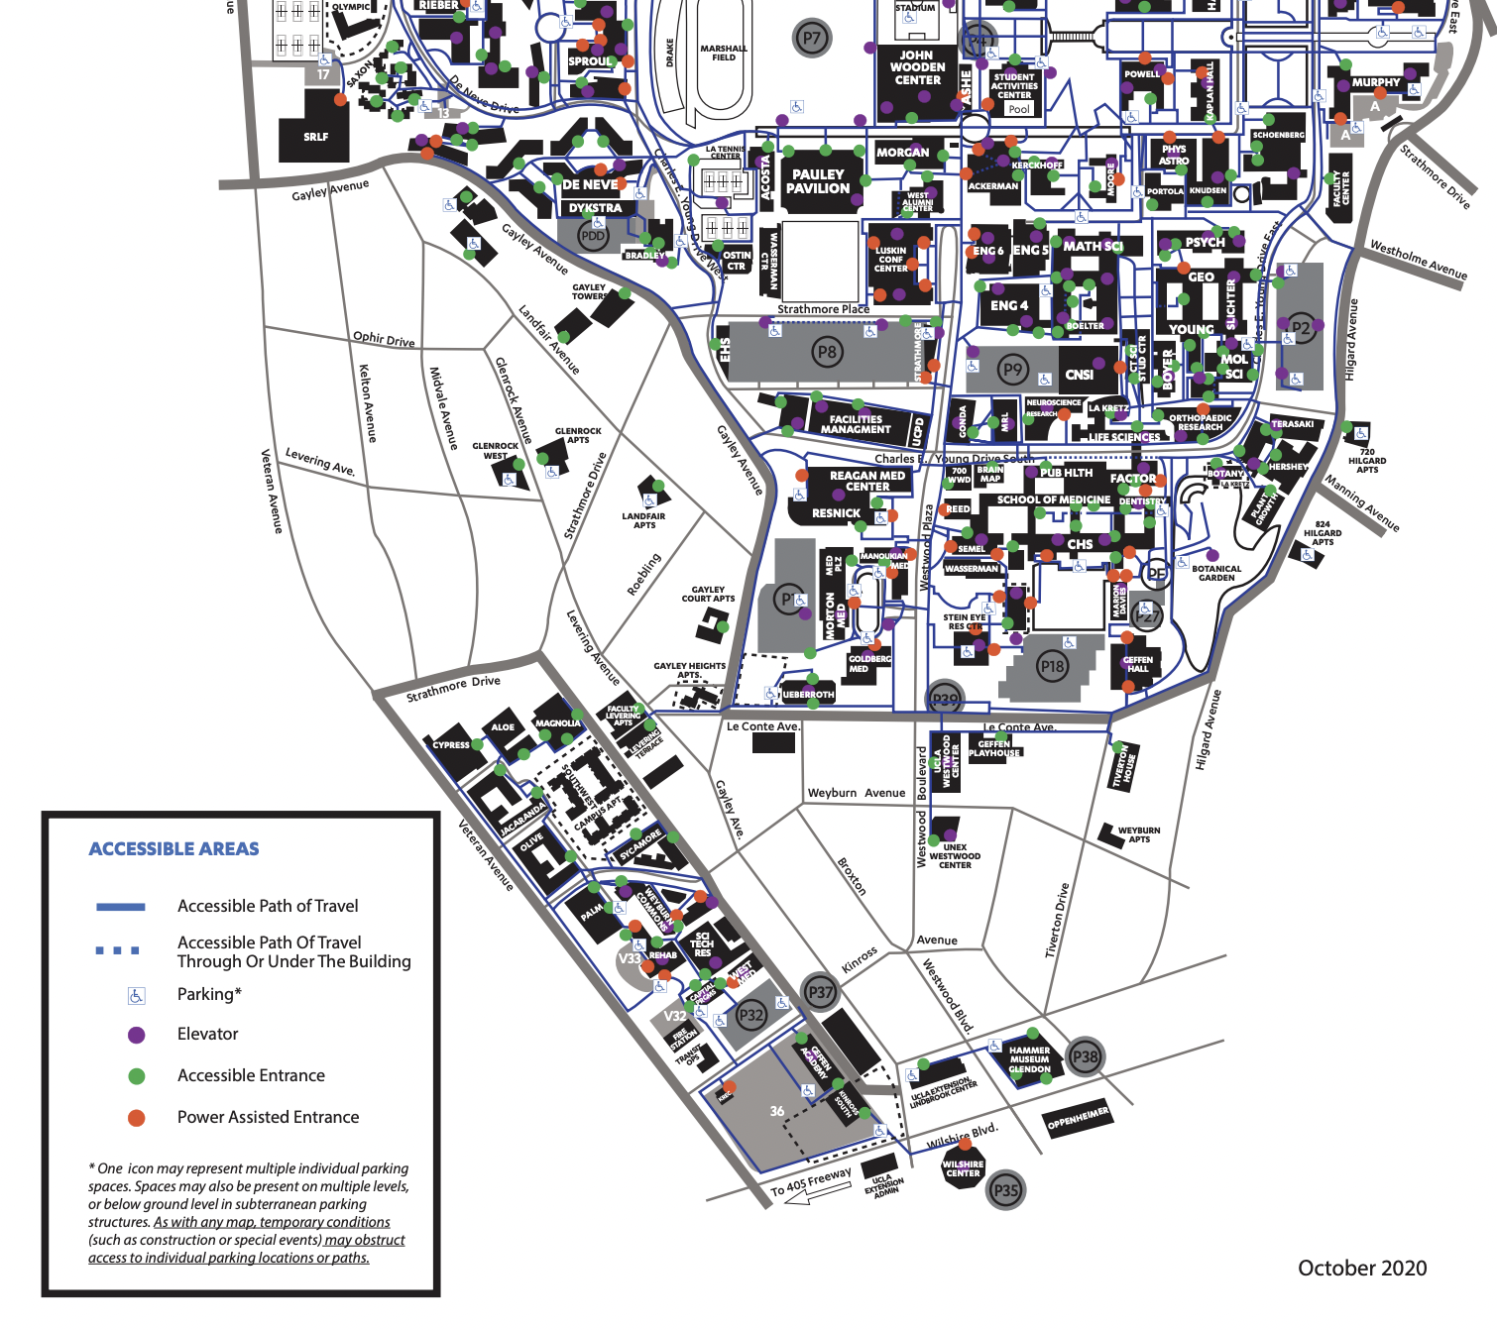
Current Accessibility Map

Slide 6
BruinRoute Solution
BruinRoute is a student-developed app designed to simplify campus navigation for students with disabilities.
User-Friendly Interface: The app offers an intuitive interface for finding accessible routes, reporting inaccessible routes, and integrating class schedules.
Improved Visibility: A minimalist design approach reduces clutter and enhances the visibility of wheelchair pathways and accessible facilities.
Personalized Features: The app will integrate personalized solutions, including adding class schedules, surveying users on various factors of importance such as length of trip or easiness of route

Slide 7
Expected Outcomes
Positive User Experience: BruinRoute aims to provide a more positive, accessible, and personalized user experience.
Enhanced Accessibility: The app seeks to enhance accessibility for students with mobility impairments at UCLA.

Slide 8
Interviews
To improve our understanding of the domain space, we will set up a time to interview Veronica Martinez-Lopez, the associate director of the UCLA Center for Accessible Education (CAE). We are hoping she will be able to provide some insight into her experiences, as well as any knowledge she might have about addressing accessibility and mobility challenges as it relates to wayfinding on UCLA’s campus.
Additionally, we are hoping to interview students from the UCLA Disabled Student Union (DSU). We will ask about their experiences with navigating campus, the routes they take, and any insights into ways in which our project might help in make navigating UCLA more accessible.

Slide 9
Interview Questions for the associate director of CAE
For the associate director of CAE:
Would you be able to provide an overview of the Center for Accessible Education Office's role and responsibilities on campus?
In your experience, what are some of the most common challenges or barriers that students with disabilities face in accessing university programs and facilities?
What advice or recommendations would you provide to a project aiming to improve accessibility on campus, such as the development of the BruinRoute app?
What specific programs, services, or facilities are most commonly addressed by your office in terms of accessibility for disabled individuals?
How do you gather feedback or input from disabled individuals or the broader campus community to inform your work and priorities?

Slide 10
Interview Questions for DSU Students
Can you describe what it was like navigating campus for the first time? Were there any issues you came across or a specific memory that stands out?
What does your route to class look like? To go home? To any of your weekly activities? (ex. clubs, grocery stores, etc.) Please specify if there are any stairs, elevators, or ramps that you use.
Can you share any insights about the physical accessibility of campus buildings and facilities? Are there areas that need improvement?
Can you talk about any instances where you felt that the campus could do more to improve accessibility and inclusivity? Any positive or negative experiences you can share?
Do you or have you ever used any maps to help you navigate campus? (specifically UCLA campus maps, ex. MetaMap)
Have you ever reported any accessibility issues? If so, how was the quality of their response? If possible, please describe the issue and process of reporting

Slide 11
Interviews
Our project is leveraging 'Metamaps,' a platform known for providing accessibility routes to those who need them on UCLA's campus. We are reaching out to former staff members such as Carolanne Link who have experience with it for their insights and advice. We're currently in the process of creating a tool that emphasizes providing accessible routes, and this decision holds several key benefits.
Consulting with previous staff members offers us valuable insights into the strengths, limitations, and potential of Metamaps in the context of accessibility on a university campus. Their expertise guides us in making informed decisions, saving us time and helping us steer clear of common pitfalls. Secondly, we're making the most of the capabilities and features that Metamaps has already demonstrated, particularly in serving the needs of individuals seeking accessible routes. This established tool accelerates our project's development process, and it aligns well with our goals. This not only saves us valuable resources but also ensures we continue to provide a valuable service for those who require accessible routes.
About MetaMaps: https://storymaps.arcgis.com/stories/b0178e304a8b4647a18157f520ee2d6
https://cio.ucop.edu/ucla-metamap-putting-accessibility-on-the-map/

Slide 12
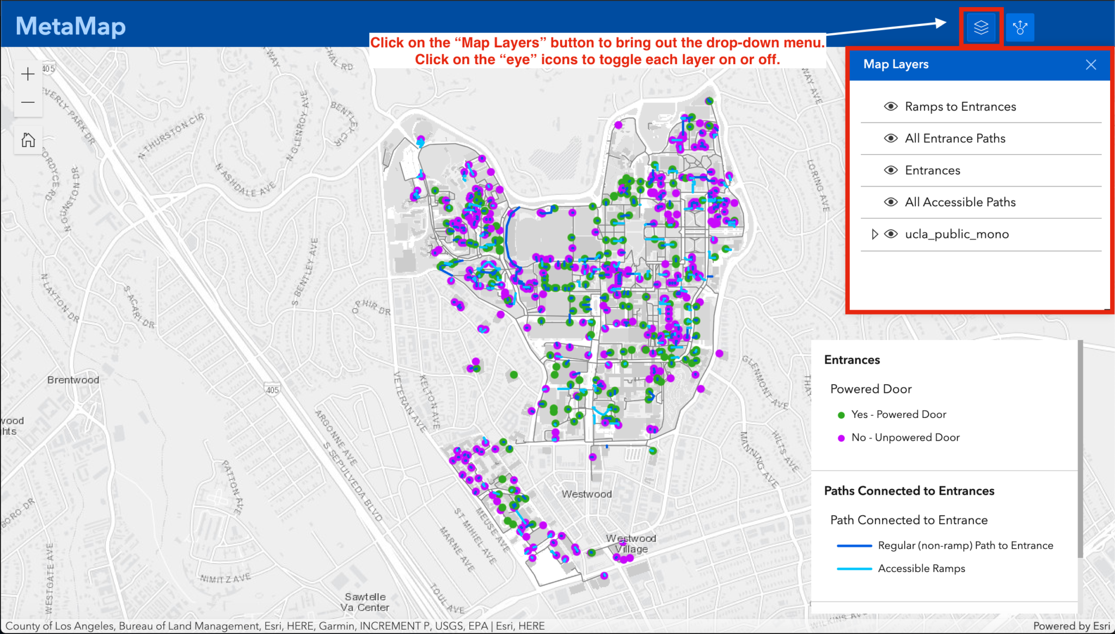

Slide 13
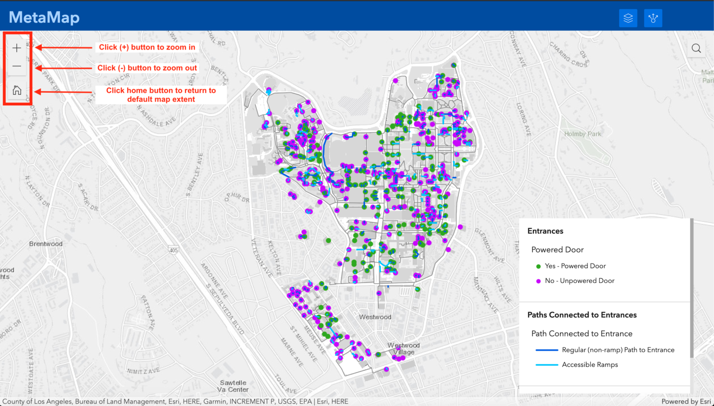

Slide 14
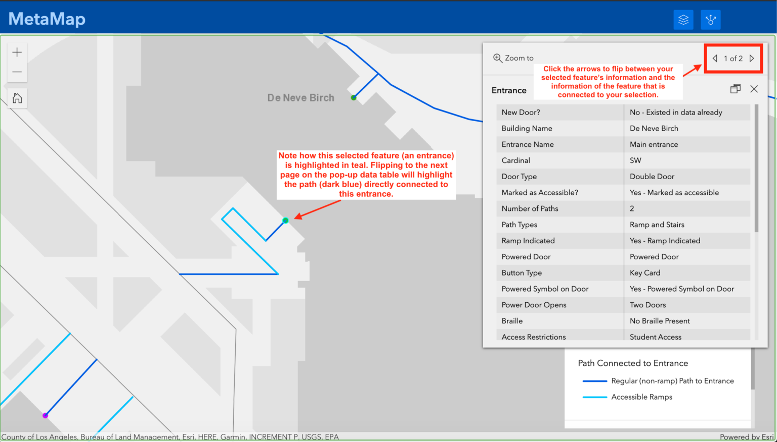

Slide 15
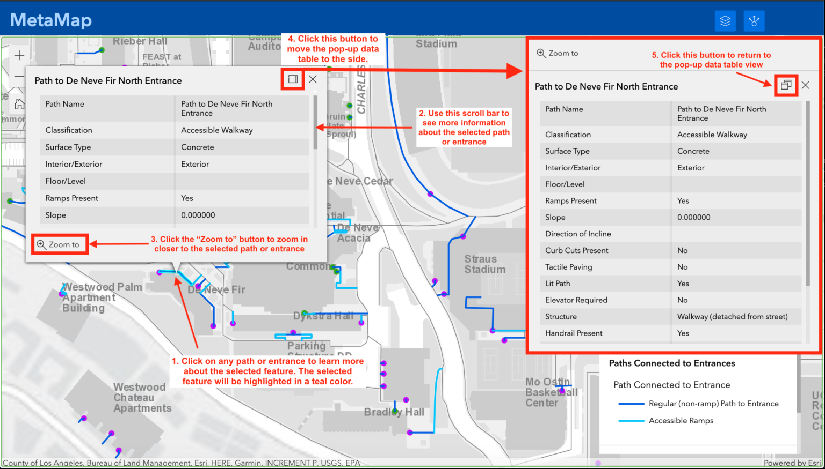

Slide 16
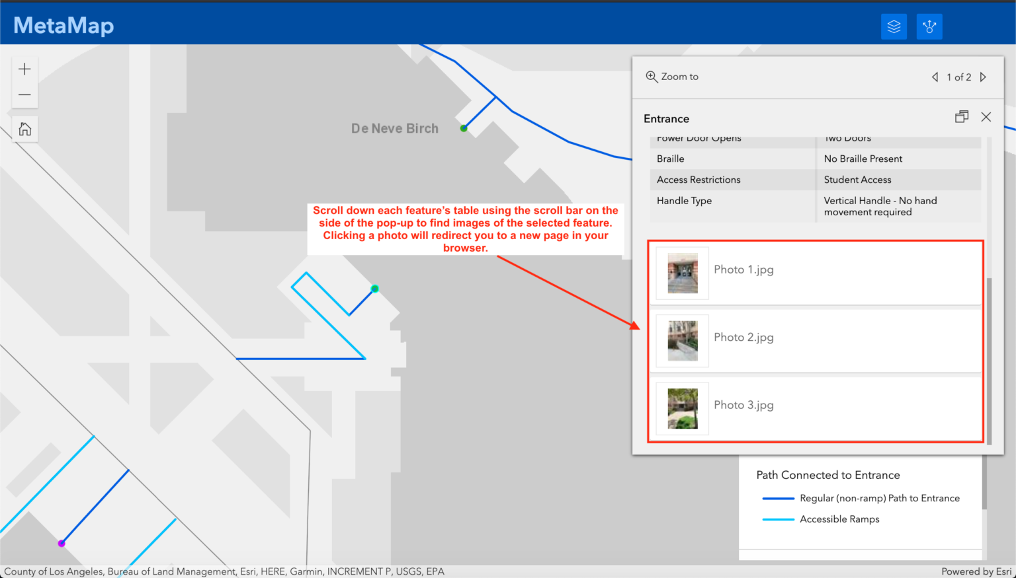

Slide 17
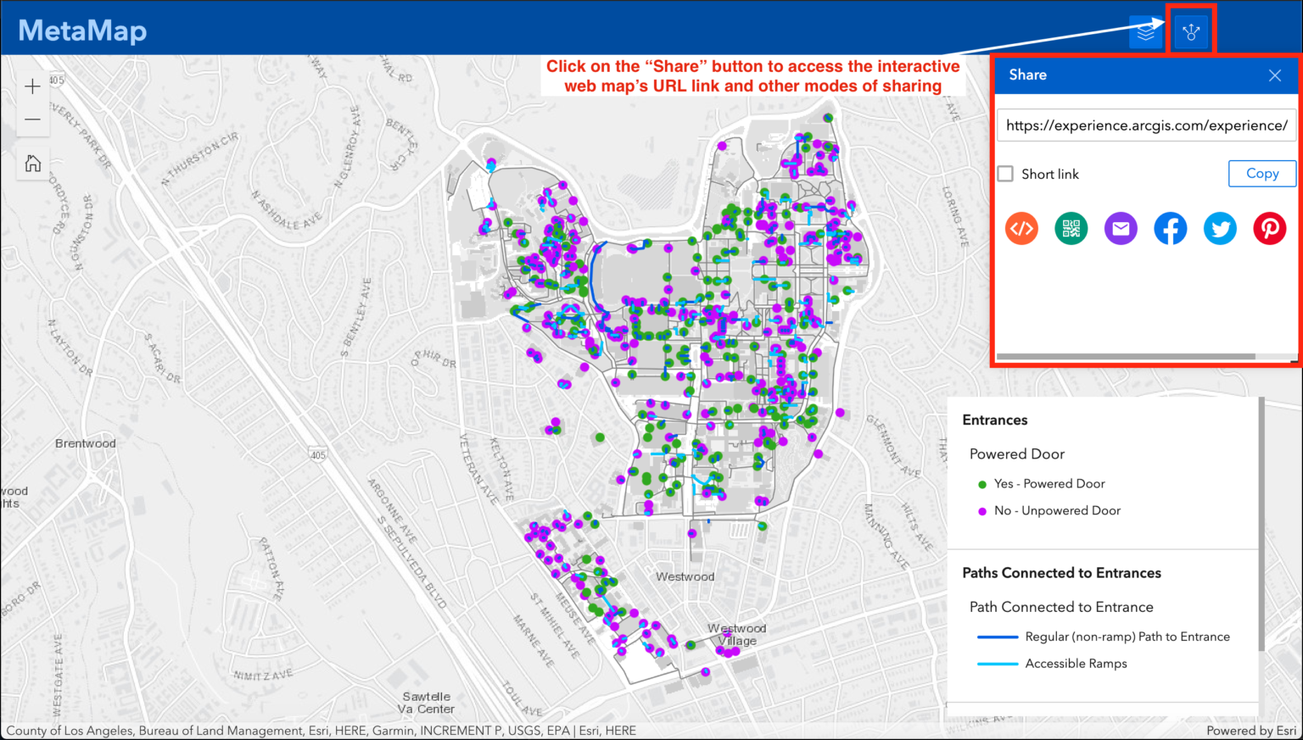

Slide 18
Questions
What were the key user feedback and experiences with the previous version of Metamaps, and how can we address them to enhance the new platform?
In terms of providing accessible routes, what were some of the notable features or strategies employed in the previous version, and how can we improve upon them?
Are there any new technologies, tools, or frameworks that have emerged since the previous version of Metamaps, which we should consider incorporating for a more robust platform?
What were the design principles and user interface considerations that contributed to the success of Metamaps, and how can we optimize the user experience on the new platform?
Were there any partnerships or collaborations in the previous project that significantly contributed to its success, and how can we establish similar partnerships or leverage their networks for the new platform?

Slide 19
Literature Review
Article Source: "Personalized Accessibility Maps (PAM) - Tailoring Solutions for Mobility-Impaired Individuals"
Key Points:
Introduction to PAM and its relevance to mobility-impaired students on college campuses.
Highlighting the need for personalized solutions based on users' unique needs and preferences.
Quote: "The current pedestrian navigation services for people with disabilities…do not offer personalized solutions" (Karimi et al., 2014).
Takeaways:
Role of user profiles in a user-centric design approach for the BruinRoute app.
Put users in control of defining their accessibility requirements

Slide 20
Literature Review
Article Source: "Mapping for Wheelchair Users: Enhancing Urban Navigation"
Key Points:
Introduction to the study on mapping for wheelchair users and its focus on urban navigation.
Highlighting the use of questionnaires and field surveys to identify accessibility barriers.
The importance of creating a GIS-based application to calculate the best routes for users.
Takeaways:
GIS technology can help create personalized accessibility maps for UCLA’s campus.
Display accessible pathways, entrances, and restrooms on the campus map through GIS layers
Store and analyze crowdsourced data for updates and improvements

Slide 21
Literature Review
Article Source: "Evaluating Wheelchair-accessible design on College Campuses"
Key Points:
Emphasizing the impact of policies and standards on accessible design.
Highlighting the gap between theoretical design standards and practical, everyday usability.
The importance of continual evaluations of accessible design in real-world contexts.
Takeaways:
Accessibility is not uniform, which is why the app offers customization options for users.
Even environments designed for accessibility may still present practical challenges.
BruinRoute can identify potential obstacles and provide alternative routes that navigate around these issues.

